Slide 1
Last Night a PowerShell DJ saved my life
Jakob Gottlieb Svendsen
Global Lead Developer / Principal consultant
CTGlobal A/S
Notes:
This is your opening. Now the stage is yours!

Slide 2
5
Video operator, did you start the recording?
Notes:
[REQUIRED SLIDE]
These slides are mandatory and help us with video post-processing. Please keep them as they are.

Slide 3
4
Notes:
[REQUIRED SLIDE]

Slide 4
3
Notes:
[REQUIRED SLIDE]

Slide 5
2
Notes:
[REQUIRED SLIDE]

Slide 6
1
Notes:
[REQUIRED SLIDE]

Slide 7
Last Night a PowerShell DJ saved my life
Jakob Gottlieb Svendsen
Global Lead Developer / Principal consultant
CTGlobal A/S
Notes:
This is your opening. Now the stage is yours!

Slide 8
How to insert your Twitter handle
1. On the Insert tab, select Header & Footer.
2. On the Slide tab, check the Footer box.
3. In the box below Footer, type your Twitter handle (e.g. @PSConfEU).
4. To prevent the footer from appearing on the title slide, check the Don't show on title slide box.
5. Click Apply to All button.

Slide 9
This Session
Learn how to mix music using PowerShell!
Understand music technology.
Be Cool!
Notes:
Please invest some time to reconsider your session: what is it that audience can get out of it? Try and be as precise as you can. If you are showing solutions, then focus on “how to”. If you present about a general technology, you’ll want to stick to “Be able to” or “Understand why/how”.

Slide 10
Agenda
Basic Setup
Communication
Bulding a virtual DJ
Putting it all together
Show off!
Notes:
Psconf.eu is about demos and code. Try and minimize use of text slides

Slide 11
Invoke-Mix

Slide 12

Music
Exclusively music from Iboga Records, Denmark www.iboga.dk
My Favorite label!
Names such as Vini Vici, Beat Bizarre, Perfect Stranger, Captain Hook, Ace Ventura and much much more!
Track names and links to buy on last slide!
Notes:
Psconf.eu is about demos and code. Try and minimize use of text slides

Slide 13
How?
Native Instruments Traktor 3
DJ Mix App
https://www.native-instruments.com/en/products/traktor/
Communication?
No API!
What, eh, how?
Notes:
Psconf.eu is about demos and code. Try and minimize use of text slides

Slide 14
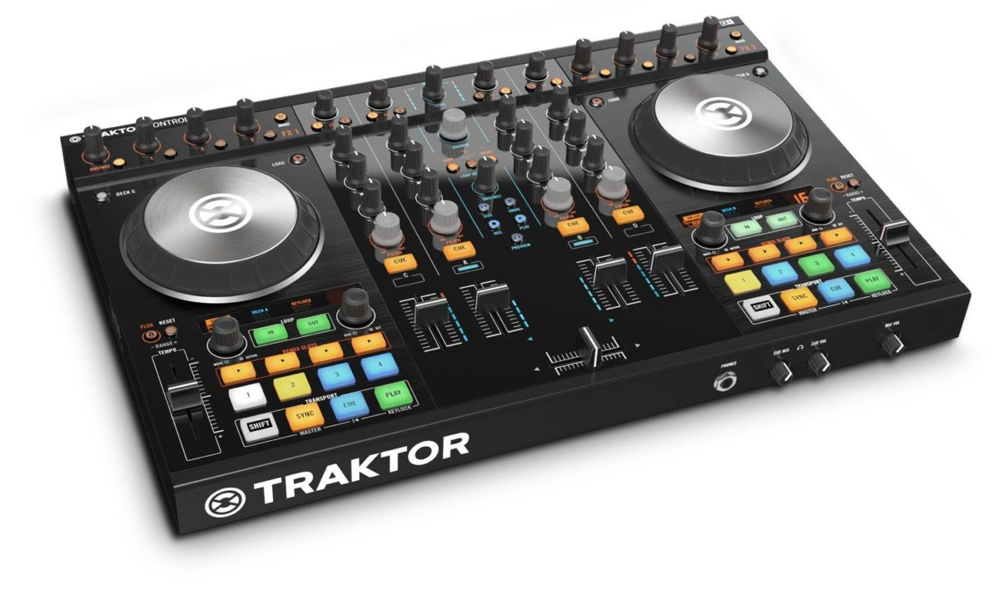
No API? What then?
Supports MIDI Controllers
Notes:
Psconf.eu is about demos and code. Try and minimize use of text slides

Slide 15
MIDI - Musical Instrument Digital Interface
loopMIDI !
Virtual MIDI loopback / ports!
https://www.tobias-erichsen.de
PeteBrown.PowerShellMidi
Enables us to communicate between PowerShell and Traktor.
https://github.com/Psychlist1972/Windows-10-PowerShell-MIDI
My Fork
https://github.com/JakobGSvendsen/Windows-10-PowerShell-MIDI
Notes:
Psconf.eu is about demos and code. Try and minimize use of text slides

Slide 16
MIDI – Communication
Notes
C,D,E,F and so on
For “play”/”stop” and so on.
CC
Values from 0 – 127.
For FX.
Clock
Sync Tempo!
Notes:
Psconf.eu is about demos and code. Try and minimize use of text slides

Slide 17
MIDI – Controlling buttons
Notes
C,D,E,F and so on
Map specific notes to specific buttons
Notes:
Psconf.eu is about demos and code. Try and minimize use of text slides

Slide 18
Lets Play!

Slide 19
MIDI – Controlling FX
Midi CC – Continuous Controller
128 Controllers per MIDI Channel (0-127)
Values from 0 – 127.
Used for FX or other knobs or faders.
Notes:
Psconf.eu is about demos and code. Try and minimize use of text slides

Slide 20
FX are cool!

Slide 21
MIDI – Clock ?
Clock is used to sync machines
Use clock in PowerShell by utilizing events!
Clock events are sent at a rate of 24 ppqn (pulses per quarter note).
My extension of the net module
https://github.com/JakobGSvendsen/Windows-10-PowerShell-MIDI/commit/70578feb4927ca47ce490deb71e26ec82fefd4fd
Notes:
Psconf.eu is about demos and code. Try and minimize use of text slides

Slide 22

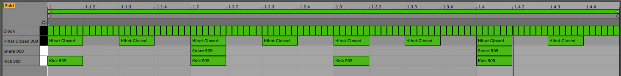
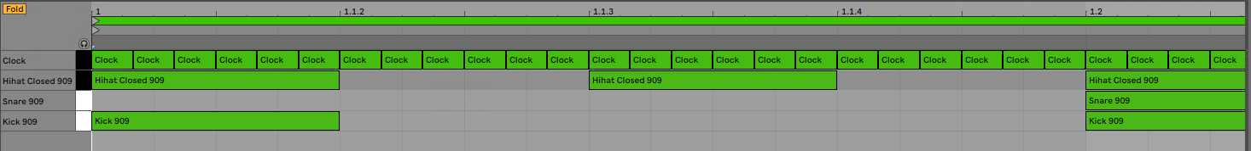
MIDI – Clock ?
Notes:
Psconf.eu is about demos and code. Try and minimize use of text slides

Slide 23
Keeping up with the tempo!

Slide 24
MIDI – Clock ?
My extension of the net module
https://github.com/JakobGSvendsen/Windows-10-PowerShell-MIDI/commit/70578feb4927ca47ce490deb71e26ec82fefd4fd
Notes:
Psconf.eu is about demos and code. Try and minimize use of text slides

Slide 25
Queue Actions!

Slide 26
Queuing Actions!
Queue next mix!
When?
X number of beats from
Now = Still hard to do right!
from certain point! (fadeout event!) = Success!
Notes:
Psconf.eu is about demos and code. Try and minimize use of text slides

Slide 27
Most people have 2 Hands!
Also known as Parallel Processing!
DJs do multiple things in sync, CPU Threads don’t!
Our body can multitask!
Disclaimer:
I know that some DJs interviewed at parties, can sound like they have only one thread, but they can actually multitask better than a CPU!
Notes:
Psconf.eu is about demos and code. Try and minimize use of text slides

Slide 28
Putting it all together
Introducing PSDJ Module
https://github.com/JakobGSvendsen/PSDJ
Notes:
Psconf.eu is about demos and code. Try and minimize use of text slides

Slide 29
Parallel Paradise Party!

Slide 30
How to get started
Step 1 – Buy cool sunglasses & music
Step 2 – Download PSDJ Module
Step 3 – Invoke-Mix!
Step 4 – Have a successful life!
Notes:
Psconf.eu is about demos and code. Try and minimize use of text slides

Slide 31
Tune in & Drop out!

Slide 32
Go buy the tracks !
Be Svendsen – Circle
https://besvendsen.bandcamp.com/album/circle-ep
One Man Orchestra – Karplus Strong
https://www.beatport.com/release/karplus-strong/1590355
FREq – Dreambody & FREq – Strange Attractors
Album: Strange Attractors
https://iboga-beatspace.bandcamp.com/album/freq-strange-attractors-iboga-records
Beat Bizarre – Monochrome
Album: Lewd - 2001
https://iboga-beatspace.bandcamp.com/album/beat-bizarre-lewd-iboga-records
Ticon – Waiting for the nights
Album: Aero – 2003
https://www.beatport.com/release/aero/1467408
Notes:
Psconf.eu is about demos and code. Try and minimize use of text slides

Slide 33
Summary
Djing is actually not that easy!
Traktor rules!
MIDI was cool even before it was cool!
Parallel threads are a pain in the record player.
Notes:
Sum up your key messages

Slide 34
Notes:
[REQUIRED SLIDE]
If you sticked to your timing, you now have 15 min left for Q&A. If you missed your timing, you will have to leave the room when your slot is over. In this case, invite your audience to the coffee break and offer to cover questions there.
IN ANY CASE please point your audience to the conference app and the session voting. By the time the conference opens, the eventraft app *should* have the option to vote on sessions.
Please MAKE SURE you leave your room when your slot is over. The next speaker would like to set him/herself up and get everything up and running.

Slide 35
about_Speaker
Jakob Gottlieb Svendsen
Global Lead Dev & Principal Consultant
CTGlobal A/S
https://ctglobalservices.com/
https://github.com/JakobGSvendsen/PSDJ
https://github.com/JakobGSvendsen/PSLegoEV3
Notes:
Do not EVER discuss this slide during your presentation. Please do not take presentation time to talk about yourself more than just a few introductory sentences. Instead, invite interested audience to the coffee break, and then talk about yourself, your job, your services, etc.
Use this slide to sum up your details. It will be part of the conference materials and recorded videos.

